Slide 1
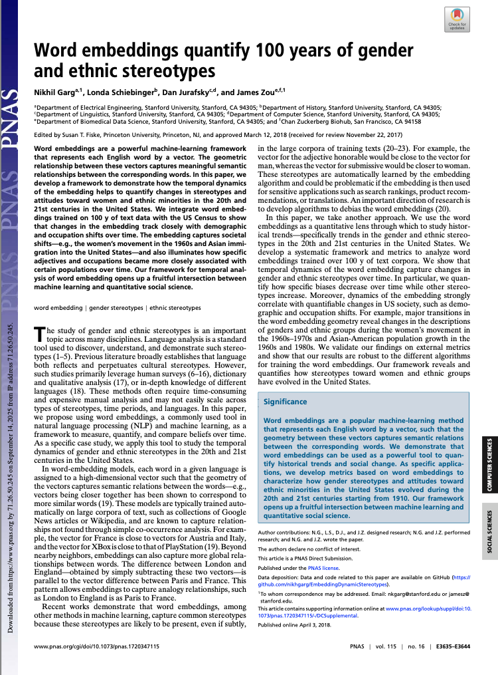
Replication Exercise
PPOL-6801
Chris Cheng
&
Muhammad Saad

Slide 2




Paper Overview
Word embeddings quantify 100 years of ethnic and gender stereotypes, 2018
Key Takeaway
Authors
Word embeddings trained on text data from the 20th and 21st century can be used to quantify/track socioeconomic trends towards gender and ethnic minorities in the US
Nikhil Garg
Londa Schienberger
Dan Jurafsky
James Zou
Collaborative effort b/w Dept. of Engineering, Computer Science, Linguistics, and Data Science at Stanford University

Slide 3
Research Framing Intuition
Do historical biases measured through embeddings match those measured through historical census/survey data in the US?
Embedding Bias
Societal Trends
Demonstrate(!)
Calculate distance between words that represent category of interest (gender, ethnicity) with words for occupations and stereotypes
Compare with independent demographic trends related to occupation rates and historical surveys
Show that embedding bias accurately captures gender/ethnic occupation rates and historical changes

Slide 4
Data & Embedding Algorithms
Use pre-trained word embeddings on Google, NYT data for text analysis. Validate through census and survey data
Text Data
Embeddings
Validation
Google News
(current)
Google Books & COHA
(1910-1990)
New York Times
(1988 - 2005)
Pre-trained word embeddings
Word2Vec(Skim-gram Negative Sampling)
GloVe
U.S. Census Data
(Occupation Rates)
Historical Surveys such as Williams & Best 1977/1990, Princeton Trilogy 1933–1969
(Stereotypes)

Slide 5
Analytical Pipeline
Use pre-trained word embeddings
Build word lists for groups (men/women and White/Asian/Hispanic) and neutral categories (occupations, adjectives)
Compute embedding bias metric using the cosine similarity metric
Compare the bias captured by the embeddings against the census and survey results

Slide 6
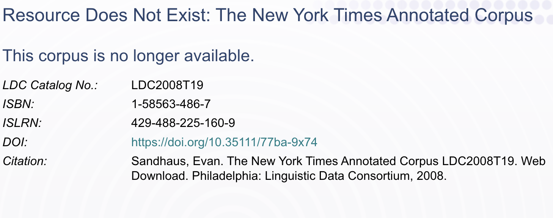

Initial Replication Challenges
Data Unavailability
Pre-trained Embeddings Mismatch
NYT Annotated Corpus no longer available (!)
No back-up with authors
Google Word2Vec embeddings used by authors trained up till 2015. Our case, till 2023.

Slide 7
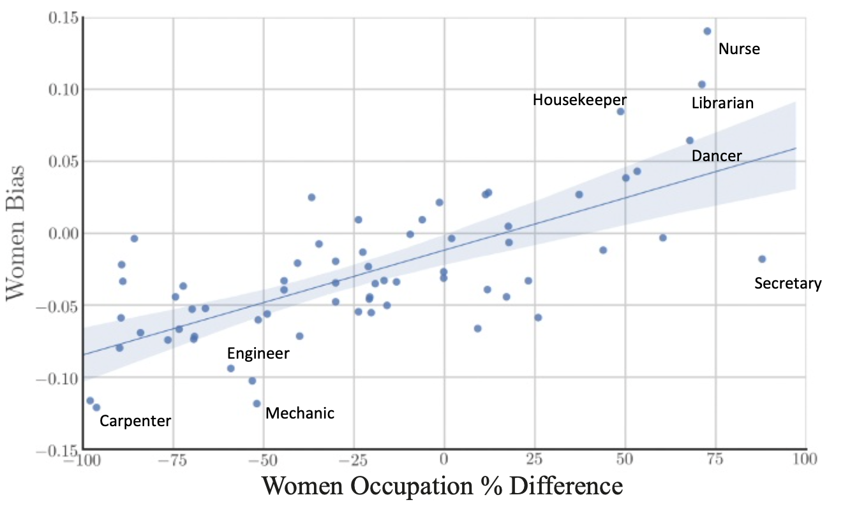
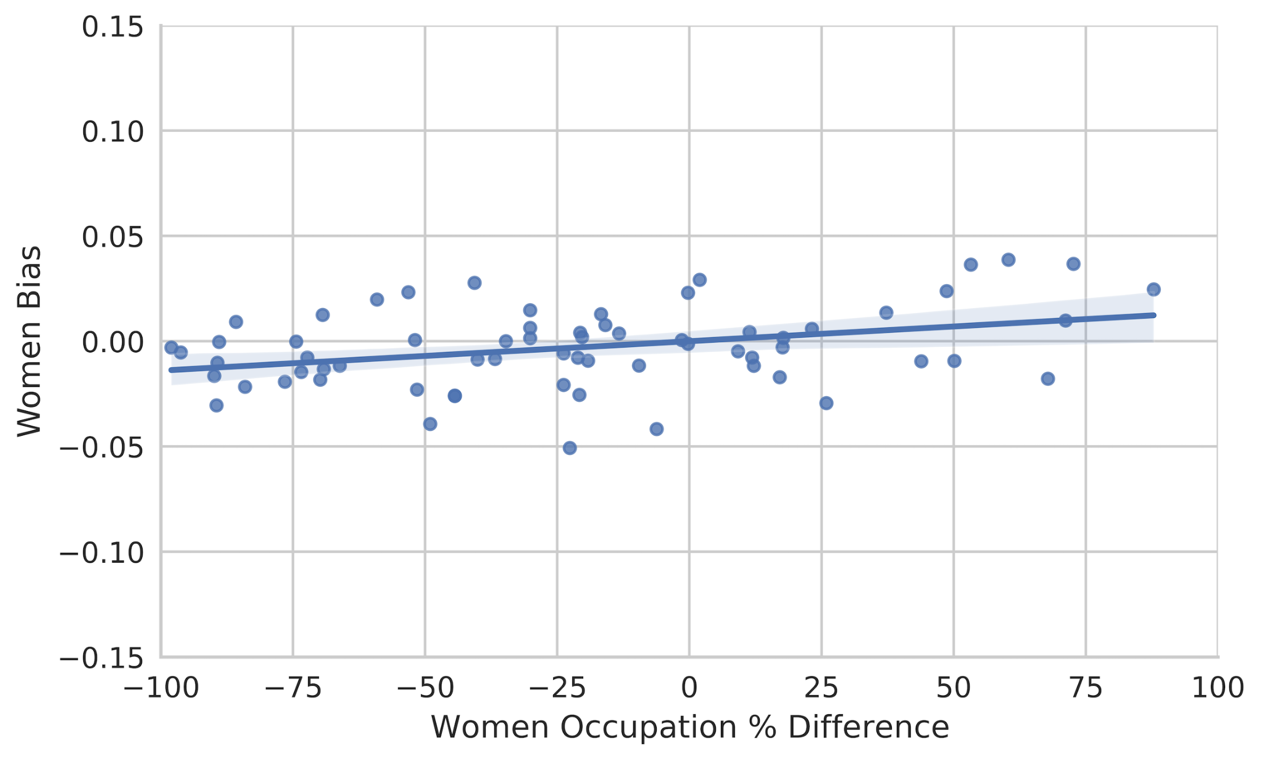
Result 1
Google News: Gender Embeddings Bias vs Gender Occupation Rate (Overall snapshot)
Study
Replication
Mismatch: Lower variance in embedding bias compared to study
Reason: Possibly data. Google News data updated from 2015 to 2023; some words might not exist in the 2023 training data

Slide 8
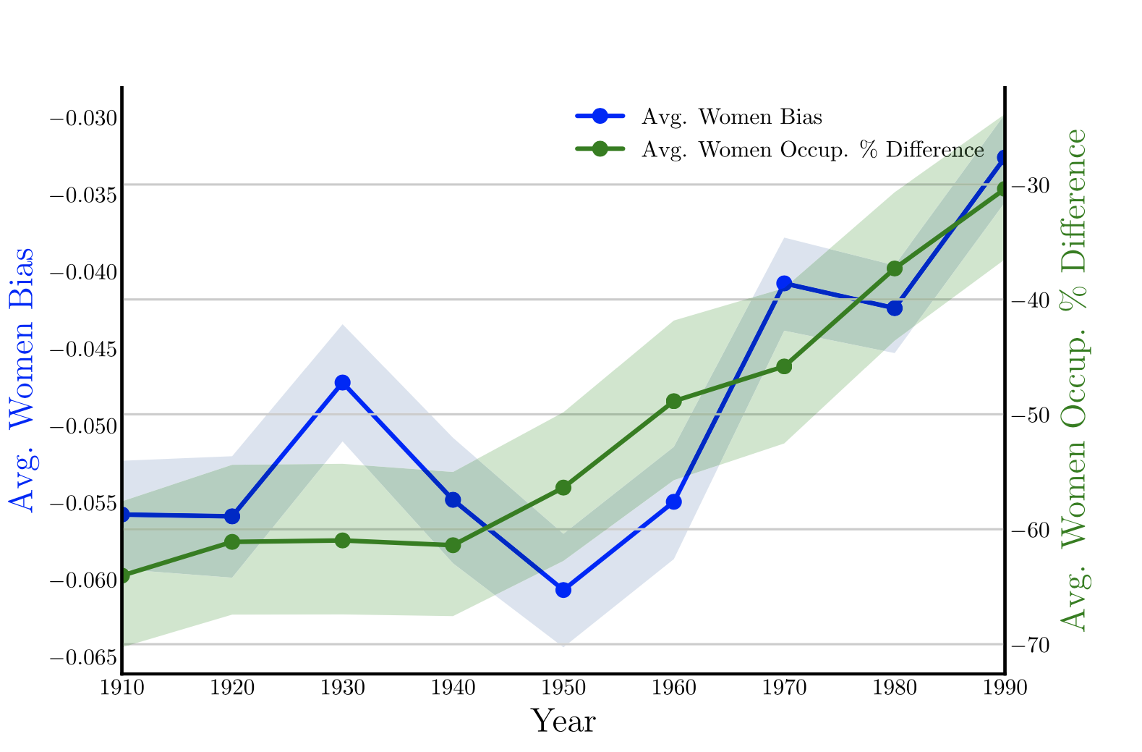
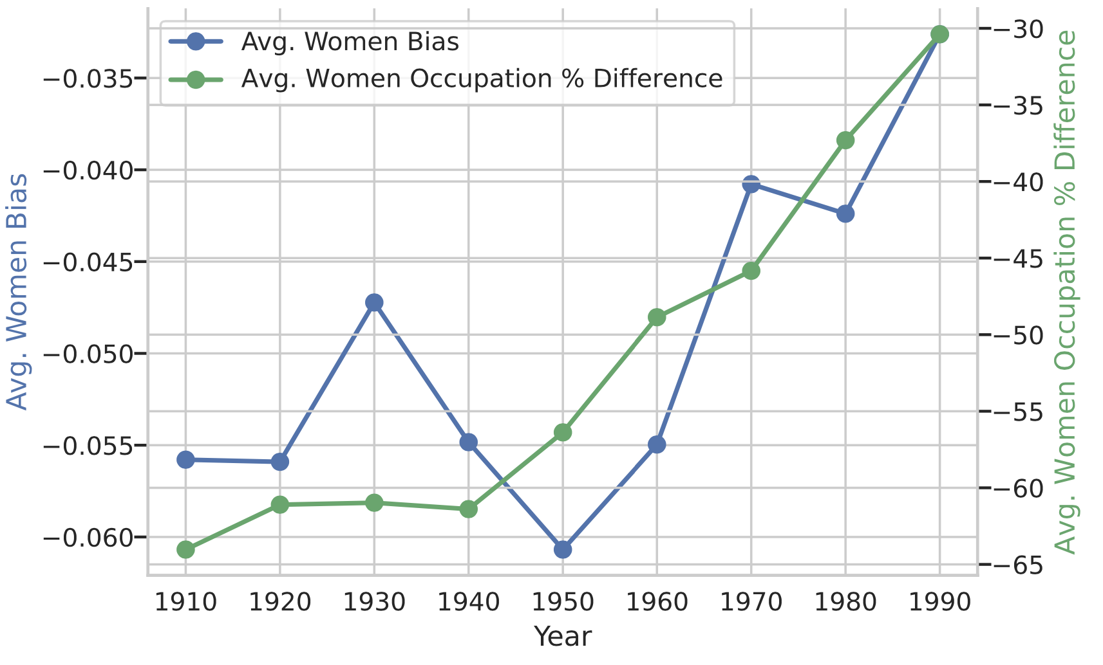
Result 2
COHA: Gender Average Embedding Bias vs Average Occupation Rate (Temporal 1910-90)
Study
Replication
Perfect replication!

Slide 9
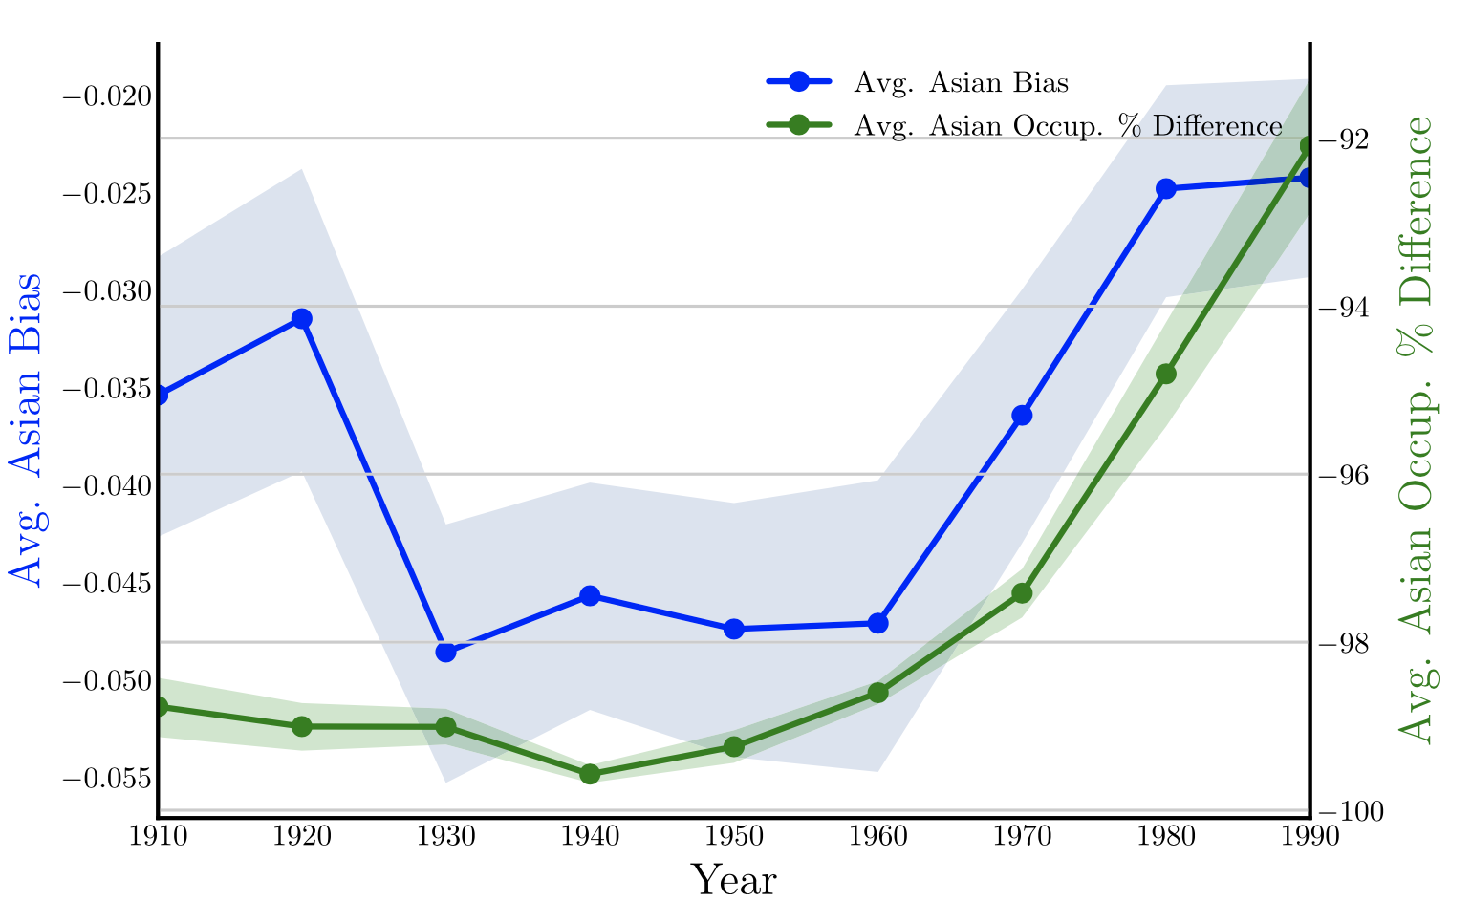
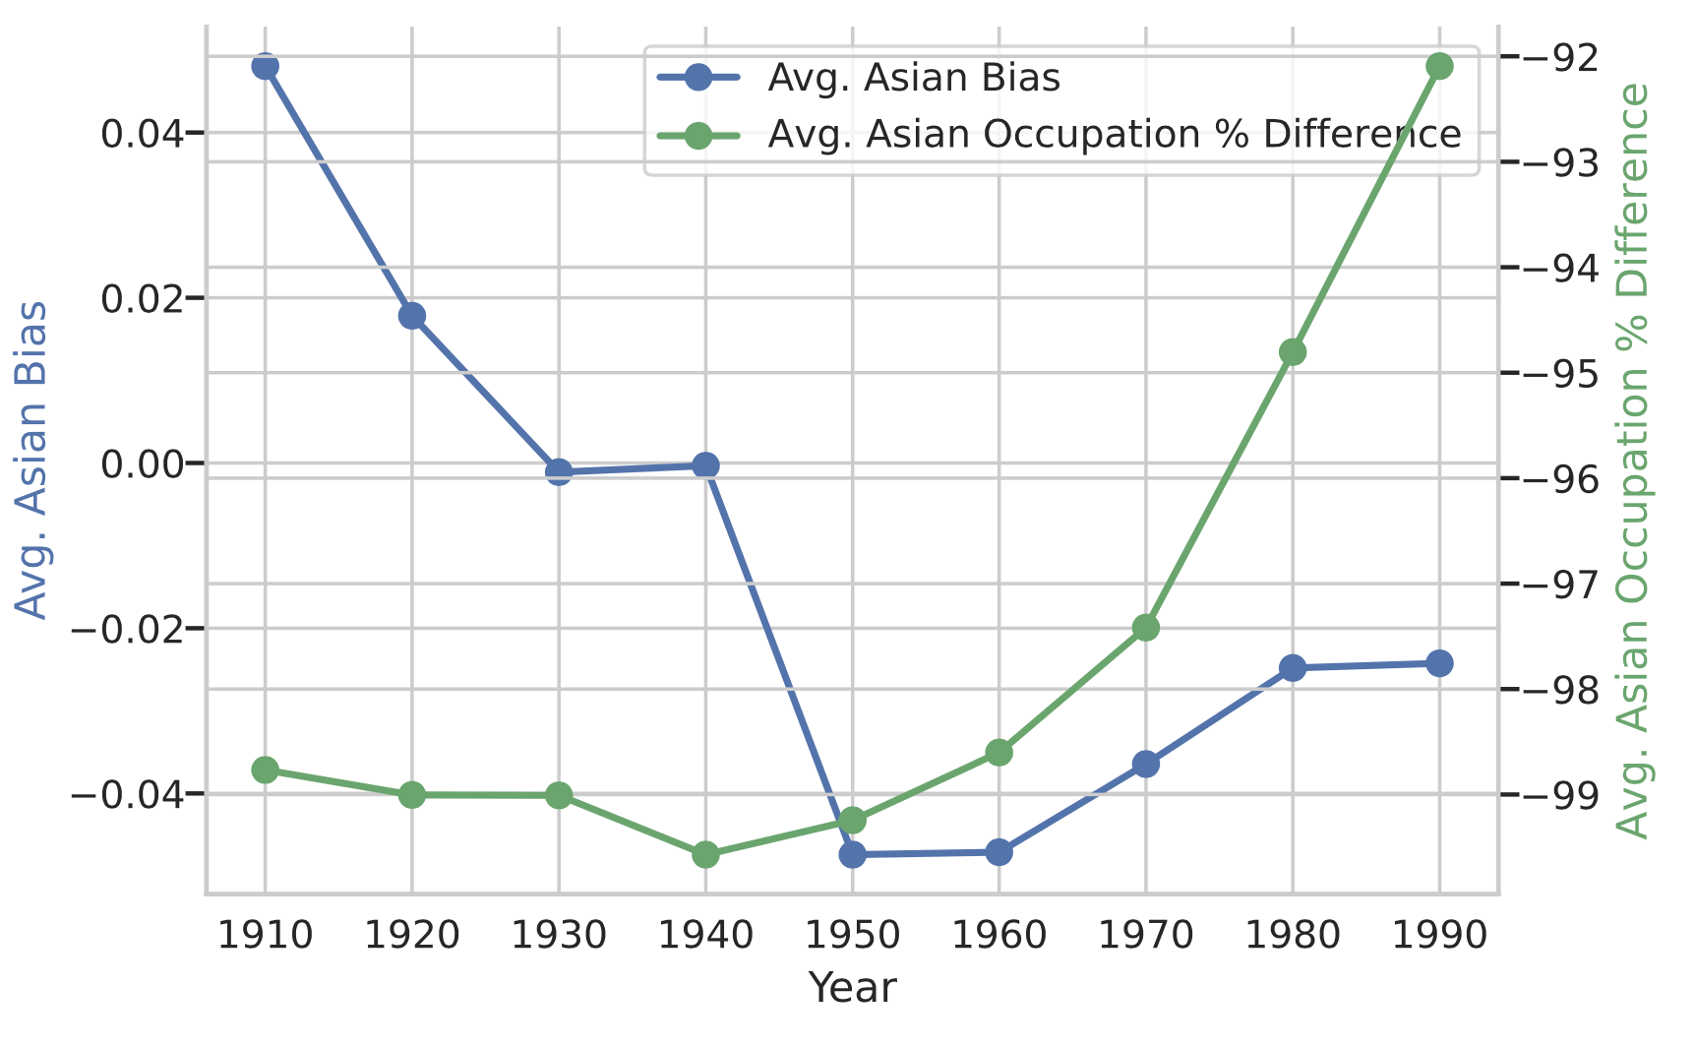
Result 3
COHA: Ethnicity Average Embedding Bias vs Average Occupation Rate (Temporal 1910-90)
Study
Replication
Mismatch: Embedding bias does not match the original study for the replication
Reason: The authors likely performed some preprocessing or filtering that they did not include in the repository

Slide 10
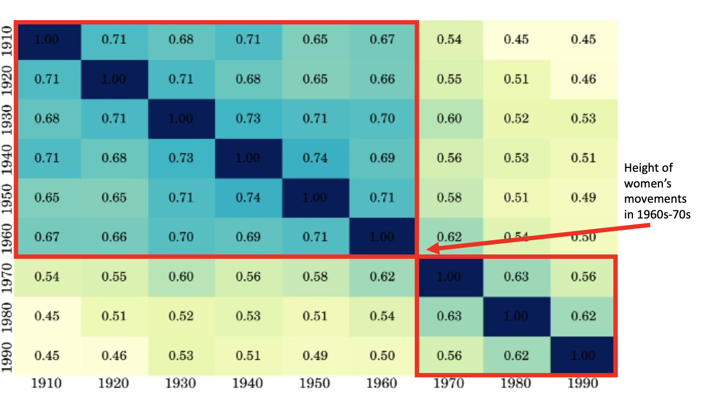
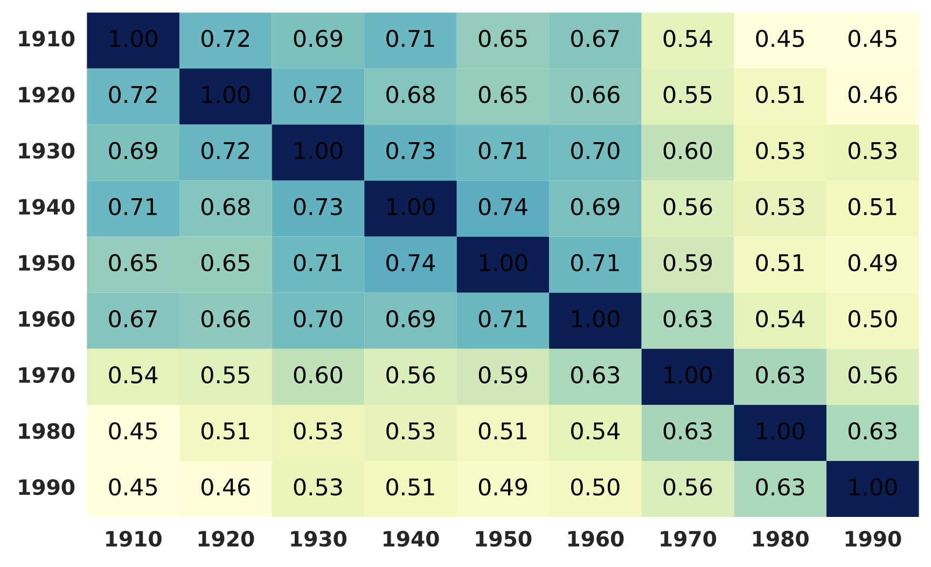
Result 4
COHA: Correlation of Embeddings Bias for Women Related Adjectives
Study
Replication
Near perfect replication…

Slide 11
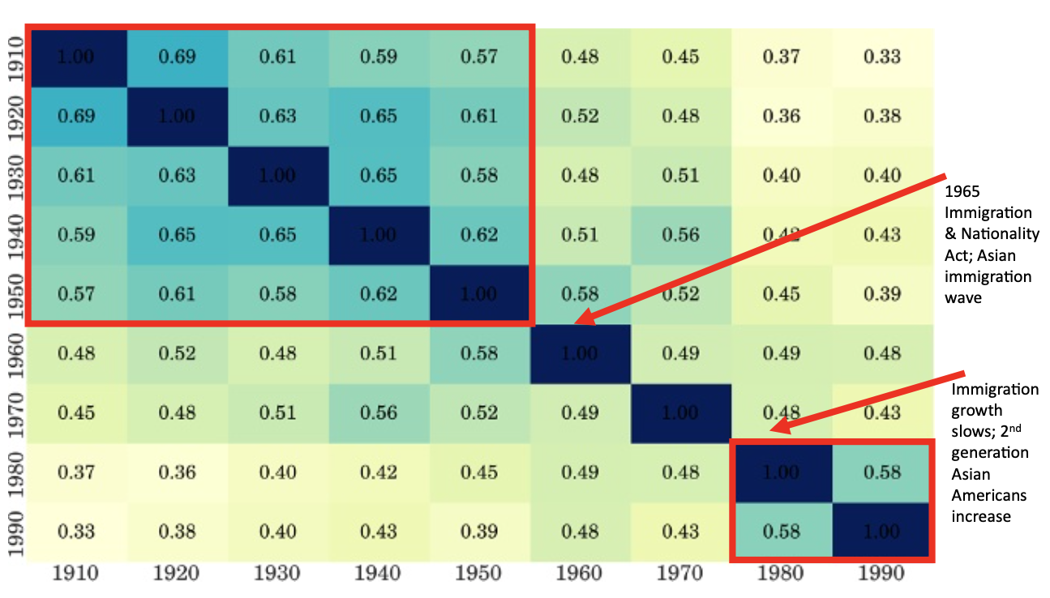
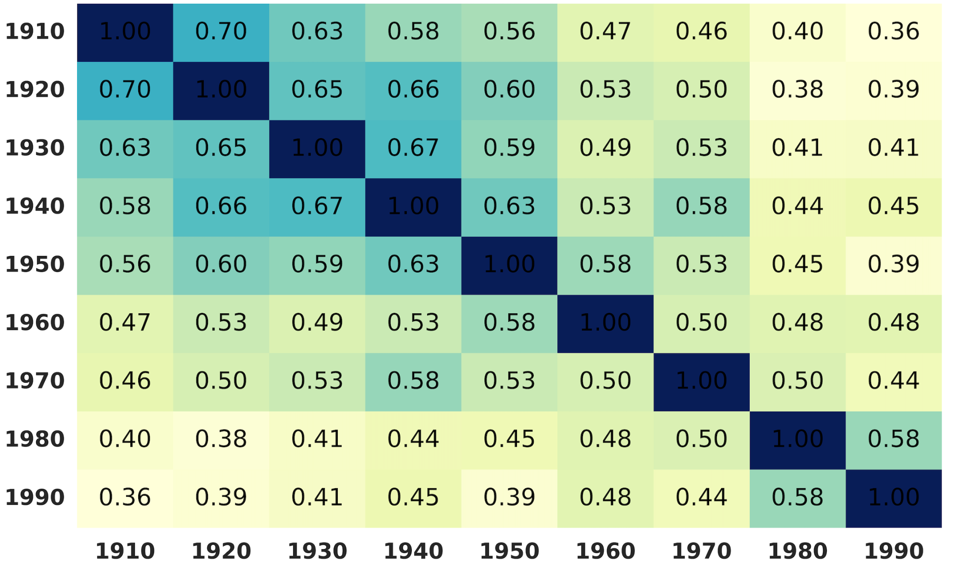
Result 5
COHA: Correlation Embeddings Bias Score for Asian Related Adjectives
Study
Replication
Near perfect replication…

Slide 12
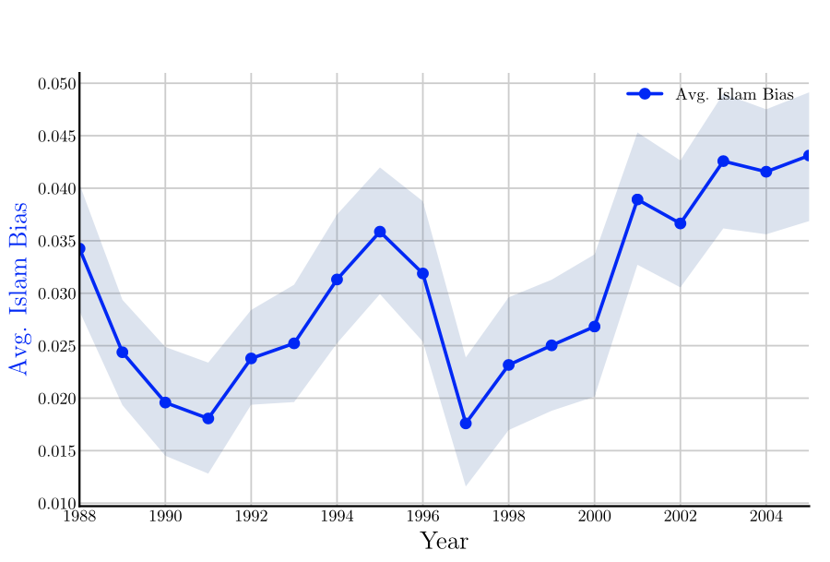
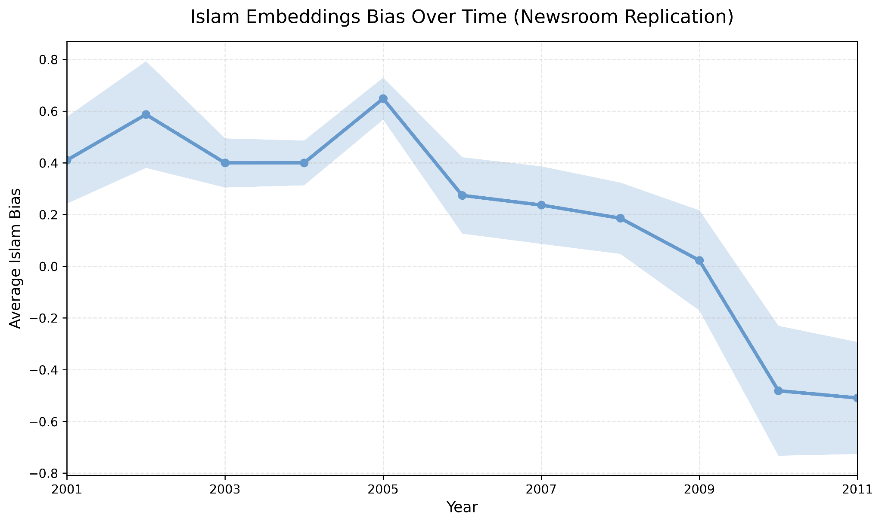
Result 6:
Islam Bias Score: NYT (Study) vs Newsroom (Replication extension)
Study
Extension
Mismatch: Used Newsroom data; only available 1998 onwards
Close correspondence b/w overall trend near 2001 for NYT and Newsroom.
Another peak in bias around 2005 (London bombings)

Slide 13


Replication Autopsy
What worked
What did not work
Repo Organization:
Incomplete scripts for preprocessing
Creation of intermediate folders not mentioned
The read_me was quite concise
Use of python2 vs python3
Study ran in 2015. A lot of the packages are slightly outdated wrt to updated python compatibility.
Had to update packages/use alternatives based on newer versions.
The overall intuition and logical flow was clear. Easy replicate aspects like bias calculations and validation checks.
Most of the data was publicly available.

Slide 14
Study Extension
We recommend using publicly accessible text data, updated embeddings and human validation as extension
Open Access Data
Updated Embeddings
Human Validation
Replace NYT Annotated Corpus with reproducible news datasets
We used Cornell NewsRoom. Other options include: HuffPost, etc
Use Transformers based embeddings (BERT) instead of SGNS
Can more accurately capture semantic meaning without word lists
Use of words lists
Key step compilation of word lists representative of different categories. Process is arbitrary and could use human reviewers.

Slide 15
Thank you!
Questions…

Slide 16
Replication problems
1.Common problems:
1)bad organize of project directory
2)not complete scripts for preprocessing
3)python2
2.A little mistake we made — used the wrong raw data
In essay the author used so called “Google Books/Corpus of Historical American English (COHA)”, and referred this as “COHA” in the main body, while the real data author used is called “eng-all” on the download page.

Slide 17
Study Extension
1.Common extensions:
1)include other topics that changes across a century, like certain kind of impression on a specific country.
2)include more word embedding sources for robustness test.
2.Using transformers embedding instead of SGNS
With SGNS, to get a less biased word vector, it require a word lists that contain synonyms and calculate the average of their vectors, while the word might be uncommon or not appear in all decades. Transformer-based word embedding method can more accurately capture the semantic meaning of words without the need of a word list.

